Slide 1
+
QuickDoc
Final Presentation
Team 4 • CS691 • Pace University
Sai Kumar kuchipudi - Project Manager
Abhinay Reddy Lakkireddy - Product Owner
Yukta Chaubal - Business Analyst
Sreenidhi Madireddy - Lead Developer
Thyagaraj Raghava – Developer
Priya Angel Dasari - Developer
Jinali Ghoghari- QA Analyst
Chalukya Garikapati - DBA
Karishma Avhad - Software Tester
Bansri Mitulkumar Patel - Software Tester
Application Overview | Diagrams | Burndown | Jenkins | Demo

Slide 2
Team 4 : QuickDoc
Agenda
2
Application Overview
BRM Diagram
Context Diagram
RoadMap
RCT (main view only)
User Stories
UML Activity Diagram
ER Diagrams
Burndown Charts
Jenkins Progress Report
Live [Recorded] Application Demo

Slide 3
Team 4 : QuickDoc
Application Overview
3
QuickDoc is a web-based medical appointment platform designed to simplify the process of finding and booking doctor appointments. It allows patients to search for doctors by specialization, view profiles, and schedule appointments online.
The platform offers features such as doctor search with filters, detailed physician profiles, real-time appointment scheduling, patient account management, appointment history tracking, reviews & ratings, prescriptions, and secure messaging.
Built with Flask and PostgreSQL, QuickDoc follows a microservice-friendly architecture with CI/CD pipelines via Jenkins, automated testing through TestRigor, and deployment on AWS EC2 using Docker containers.

Slide 4
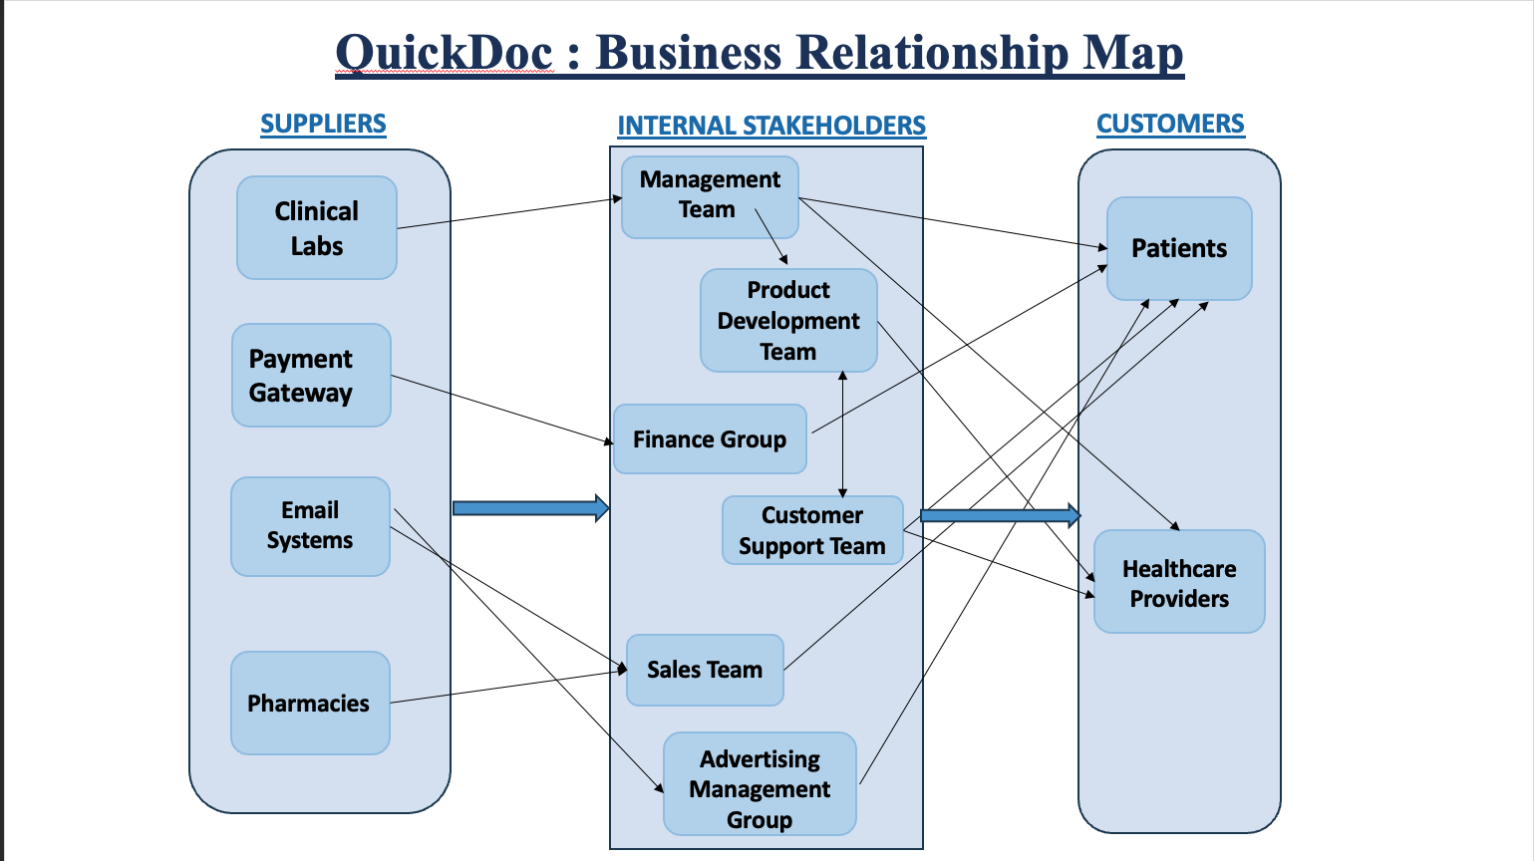
Team 4 : QuickDoc
BRM Diagram
4
[Insert BRM Diagram Screenshot Here]

Slide 5
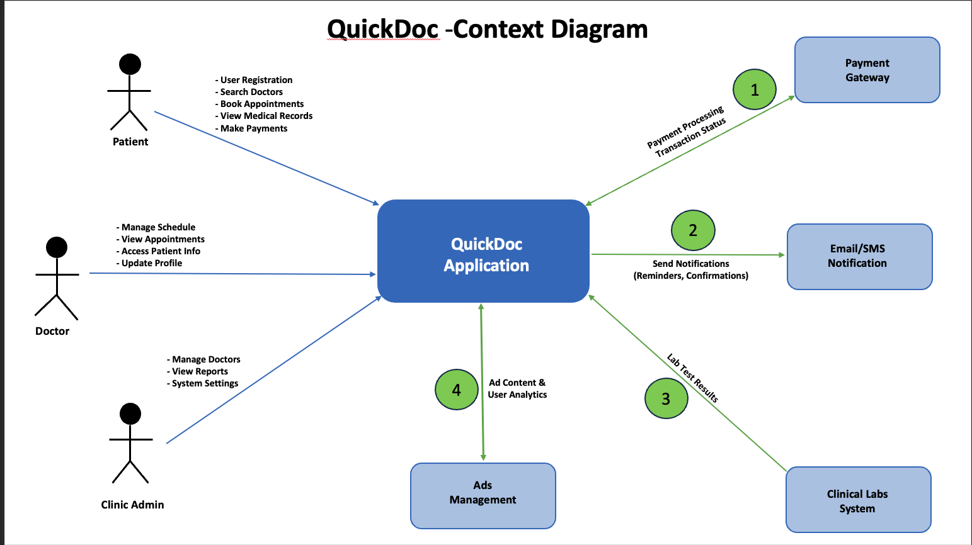
Team 4 : QuickDoc
Context Diagram
5
[Insert Context Diagram Screenshot Here]

Slide 6
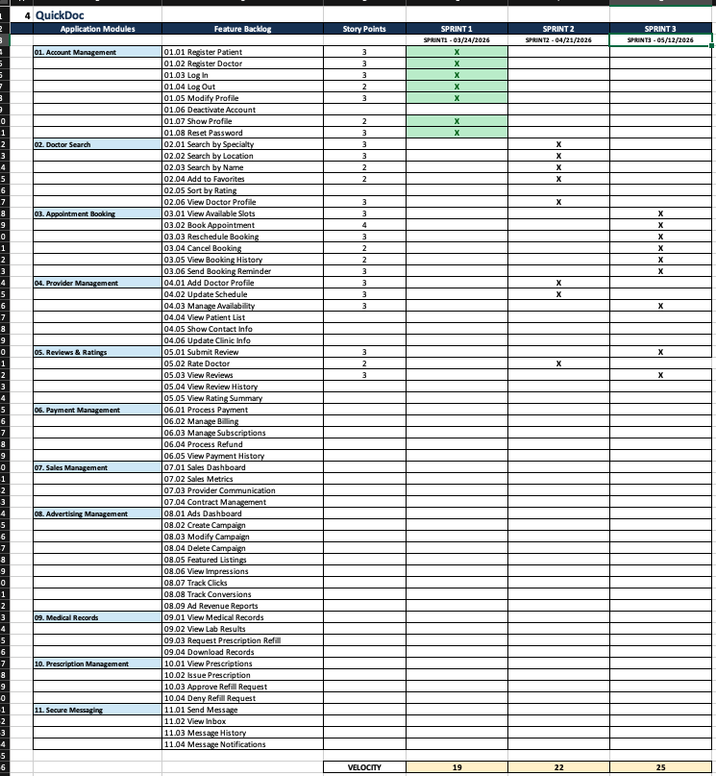
Team 4 : QuickDoc
Road Map
6
[Insert Road Map Screenshot Here]

Slide 7
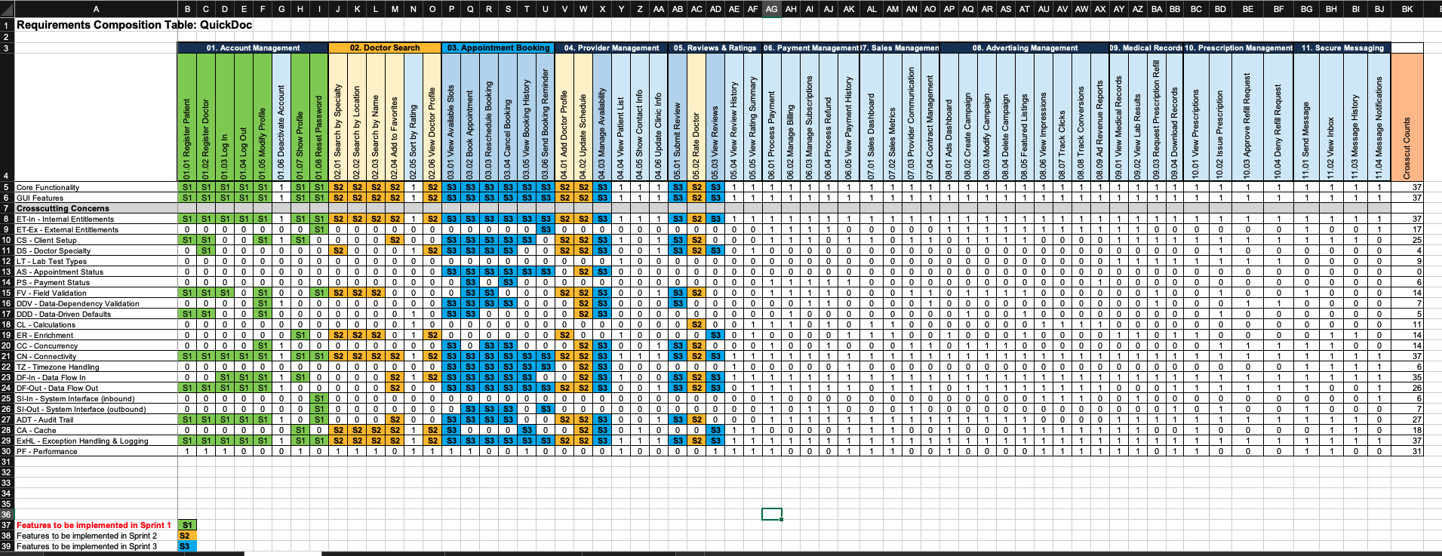
Team 4 : QuickDoc
RCT — Main View Only
7
[Insert RCT Main View Screenshot Here]

Slide 8
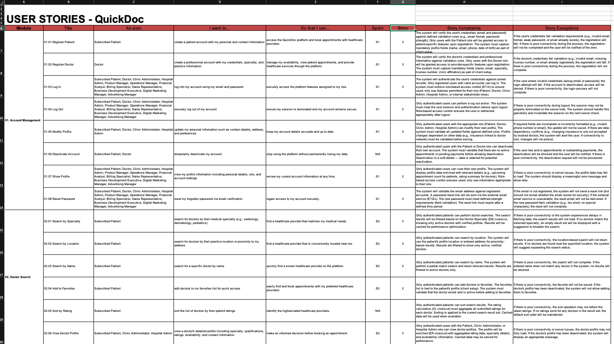
Team 4 : QuickDoc
User Stories
8
[Insert User Stories Screenshot Here]

Slide 9
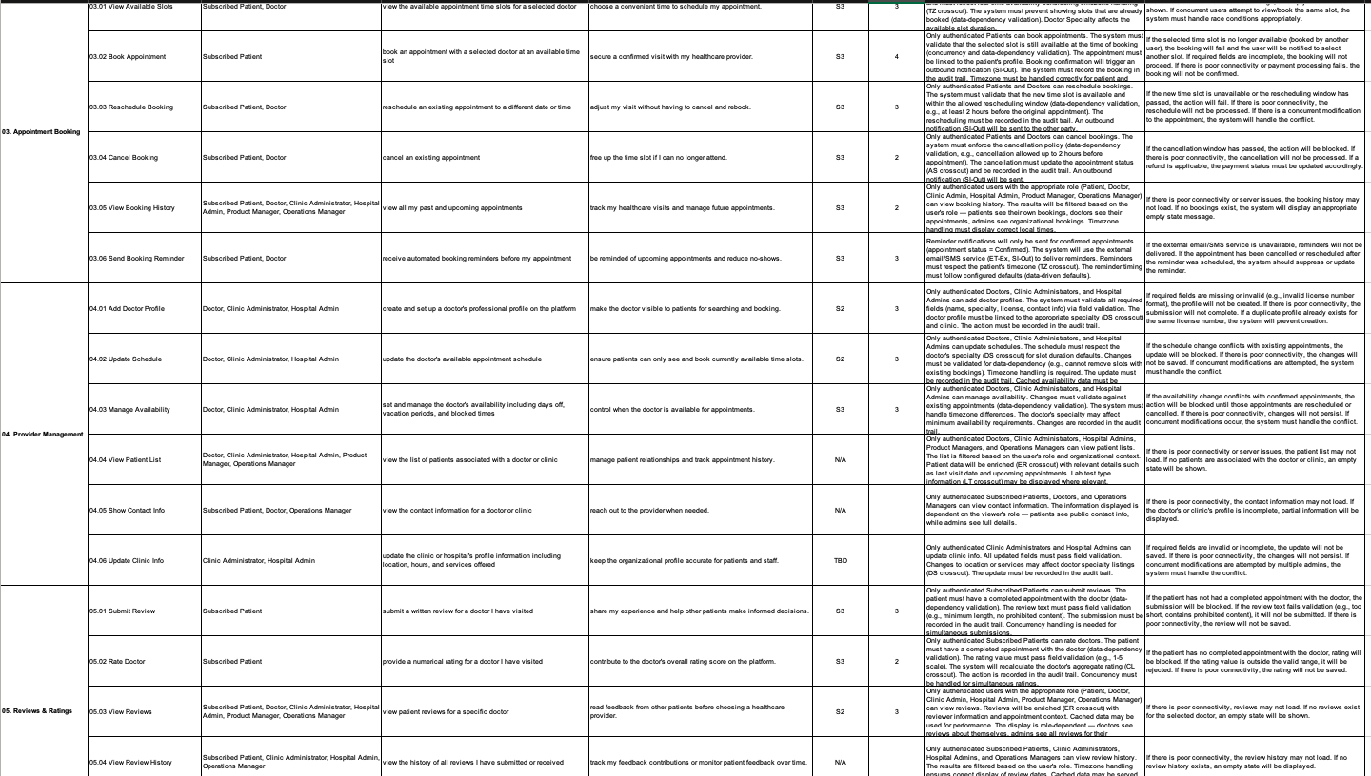
Team 4 : QuickDoc
User Stories
8
[Insert User Stories Screenshot Here]

Slide 10
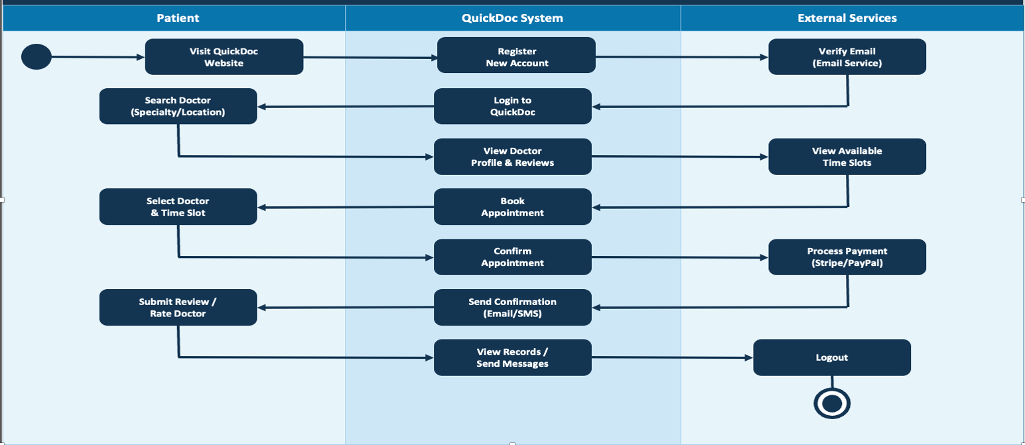
Team 4 : QuickDoc
UML Activity Diagram
9
[Insert UML Activity Diagram Screenshot Here]

Slide 11
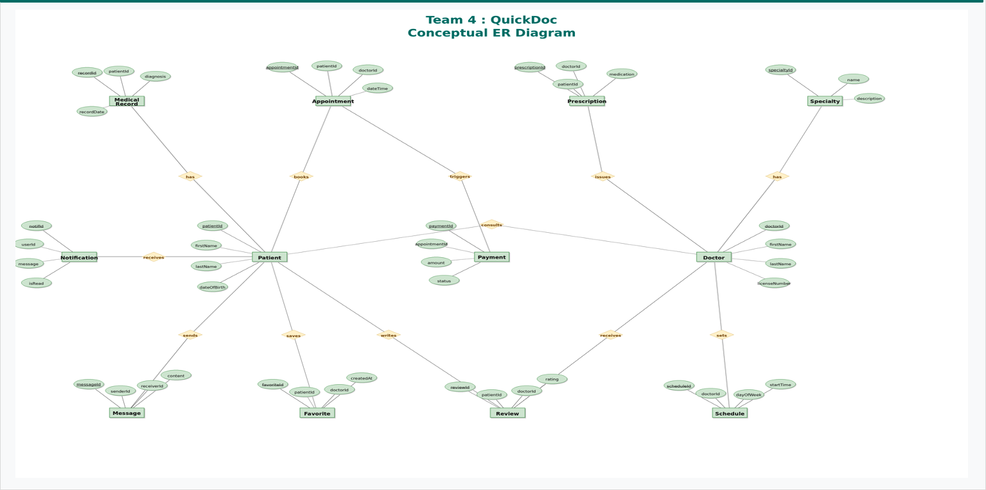
Team 4 : QuickDoc
Conceptual ERD — Diagram
12
[Insert Conceptual ER Diagram Screenshot Here]

Slide 12
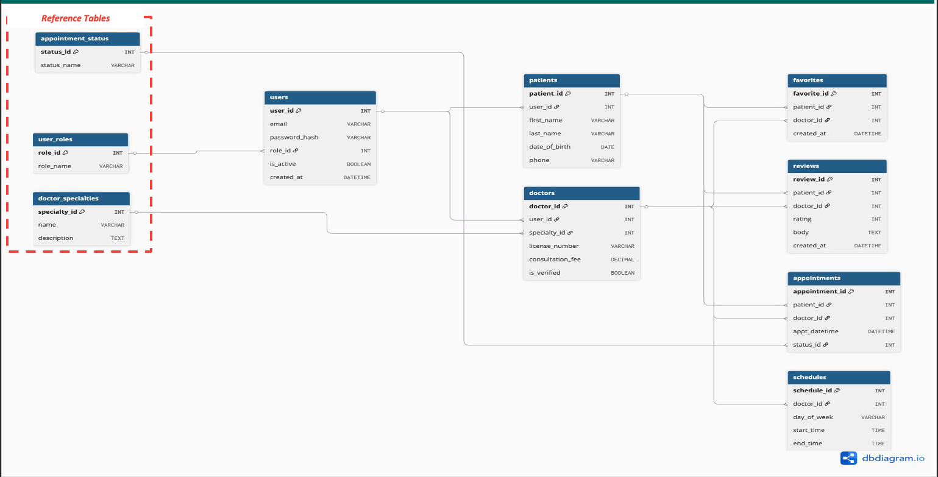
Team 4 : QuickDoc
Logical ERD — Diagram
13
[Insert Logical ER Diagram Screenshot Here]

Slide 13
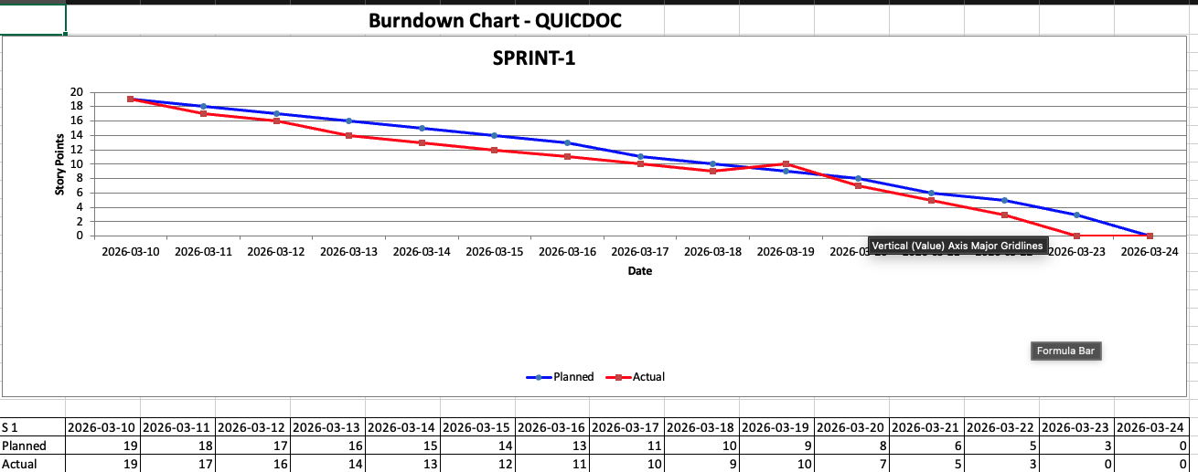
Team 4 : QuickDoc
Burndown Chart — Sprint 1
14
[Insert Sprint 1 Burndown Chart Here]

Slide 14
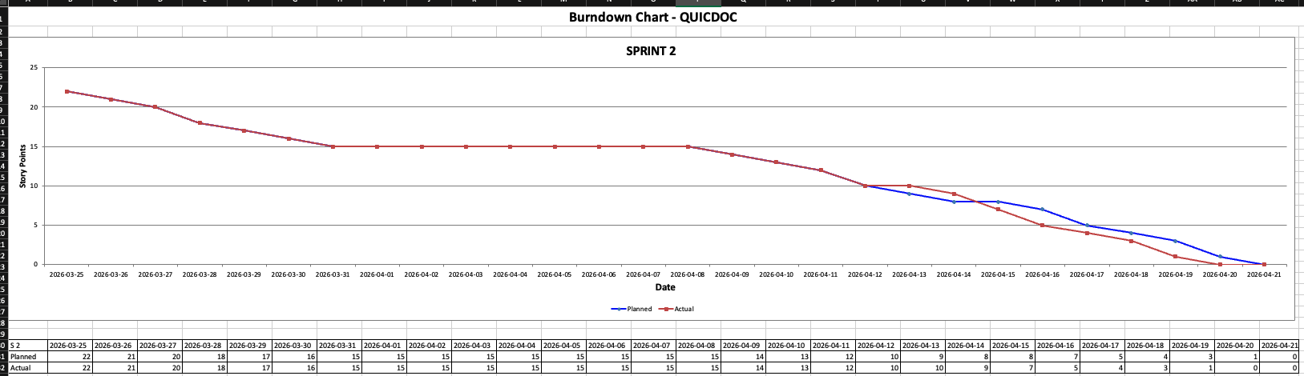
Team 4 : QuickDoc
Burndown Chart — Sprint 2
15
[Insert Sprint 2 Burndown Chart Here]

Slide 15
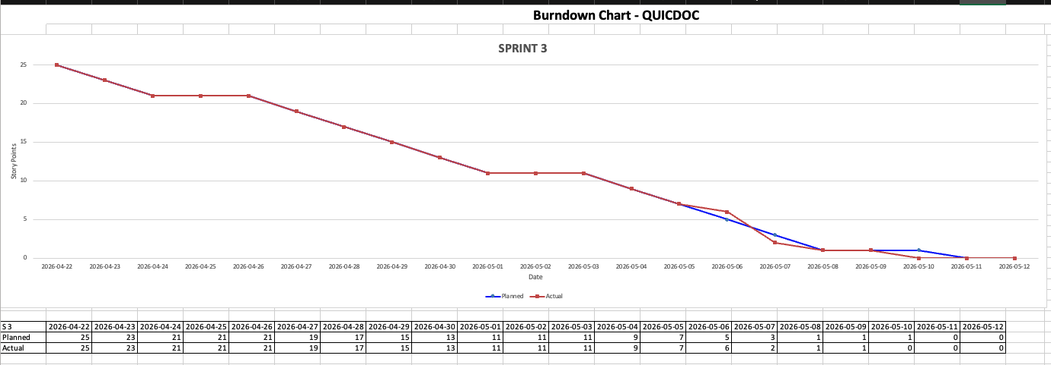
Team 4 : QuickDoc
Burndown Chart — Sprint 3
16
[Insert Sprint 3 Burndown Chart Here]

Slide 16
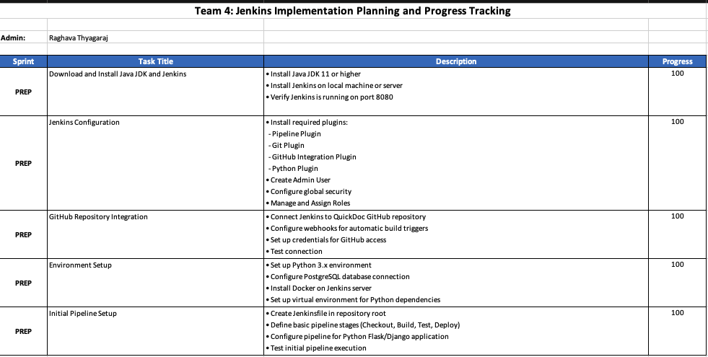
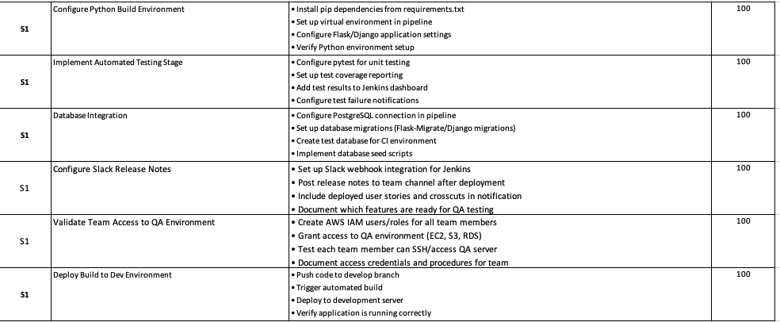
Team 4 : QuickDoc
Jenkins Progress Report
17
[Insert Jenkins Progress Report Screenshot(s) Here]

Slide 17
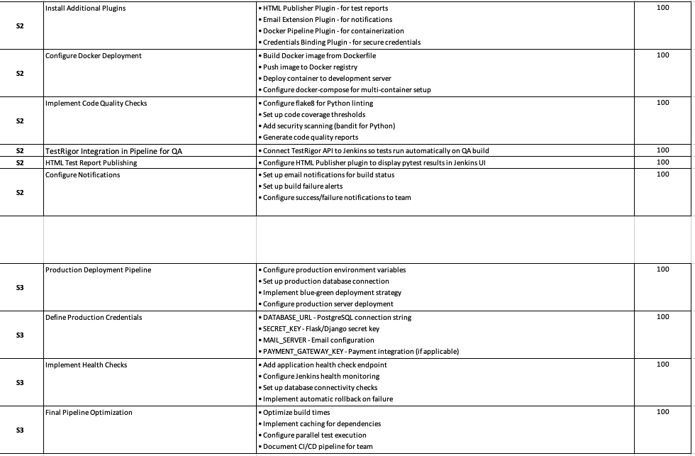
Team 4 : QuickDoc
Jenkins Progress Report
17
[Insert Jenkins Progress Report Screenshot(s) Here]

Slide 18
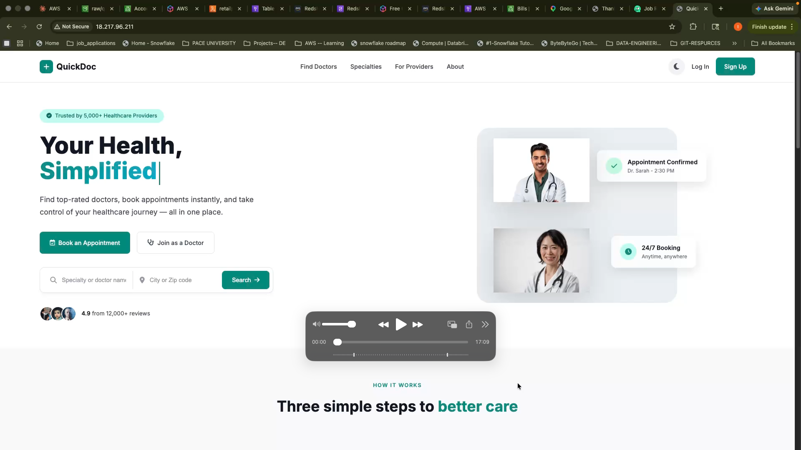
Team 4 : QuickDoc
Live Demo
18
[Insert Application Demo Screenshot(s) Here
or switch to live/recorded demo]

Slide 19
+
QuickDoc
Thank You!
Team 4 • CS691 • Pace University

